Slide 1

First Steps with R in Life Sciences: Graphics
With slides from: Diana Marek, Geoffrey Fucile, Alex Smith, Linda Dib, Leonore Wigger, Wandrille Duchemin

Slide 2
Exam – 0.5 ECTS Take-home exam: data analysis tasks, available on course page.
Exam is graded as "pass" or "fail".
Submit analysis to your teacher in one week (ask for their e-mail).
If you pass, you will receive a certificate of achievement from the SIB Training Team, which you can submit to your educational institution.
If you don't take the exam, you will receive a certificate of attendance.

Slide 3
Building graphics in R

Slide 4
R graphics
R is powerful for plotting graphs and figures. It provides several plotting systems:
base (widely used, comes with basic R installation)
ggplot2 (widely used, implements the Grammar of Graphics (Wilkinson, Springer (2005)))
lattice (mainly used for specialized needs, e.g. 3D plots)
They have very different syntaxes, cannot be mixed, and need to be learned separately. This course introduces the R base plotting system.

Slide 5
R base plotting system
Plots are built up step by step with multiple function calls.
High-level graphics functions:
draw a new plot.
Tailor its appearance with optional arguments.
Low-level graphics functions: add graphical elements to an existing plot, piece by piece.

Slide 6
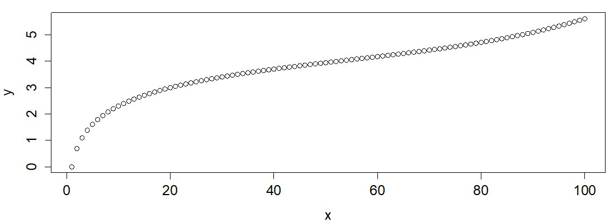
Plotting – the basics
Generic function plot():
plots a variable y against a variable x.
argument type : type of plot ("l" for lines, "p" for points, "b" for both, etc.). The default is points.
x <- 1:100
y <- log(x) + (x/100)^5
plot(x,y) # equivalent to plot(x, y, type="p")

Slide 7
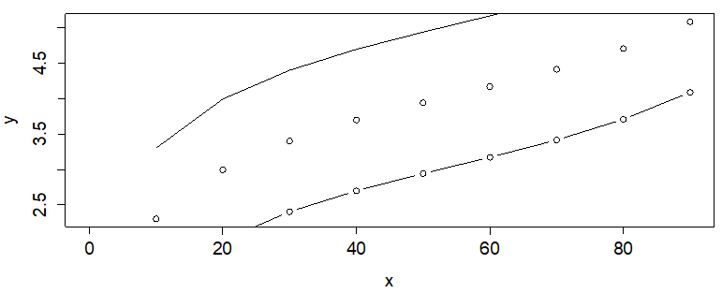
Adding elements to a plot
a new plot is created every time the plot() function is called .
low-level plotting commands: add graphical elements to an existing plot
points() to add points to an existing plot
lines() to add a line to an existing plot
These function also have the type argument (e.g., "l" for lines, "p" for points and "b" for both).
x <- seq(0,100, by=10)
y <- log(x) + (x/100)^5
plot(x,y)
lines(x,y+1)
points(x,y-1, type="b")

Slide 8
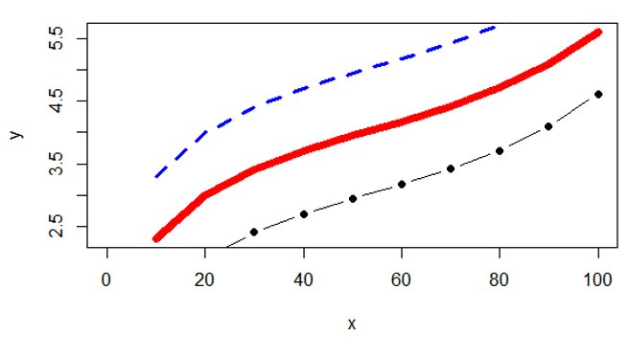
Customizing plots (I)
plot(), points() and lines() all take customizing arguments, including:
col indicating the colour
lwd indicating the line width
lty indicating the line type
pch indicating the plotting character (symbol)
plot(x, y, type="l", col="red",
lwd=7)
lines(x, y+1, col="blue",
lty="dashed")
points(x, y-1, type="b",
pch=19)

Slide 9
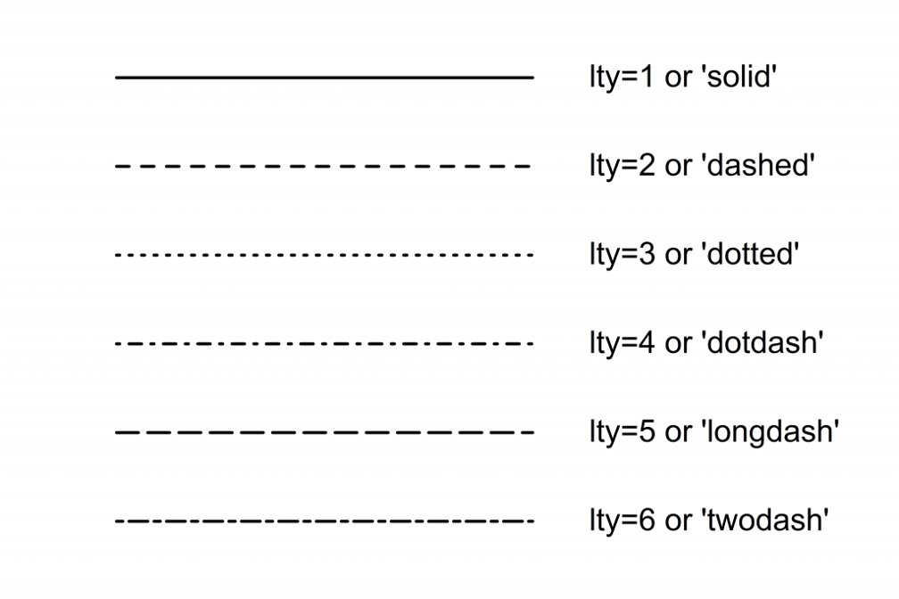
R line types, to use with lty

Slide 10
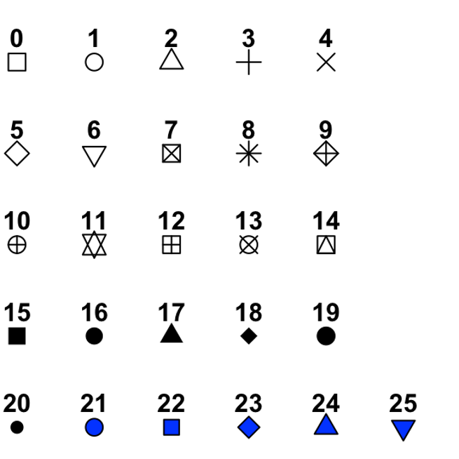
R plotting characters, to use with pch

Slide 11
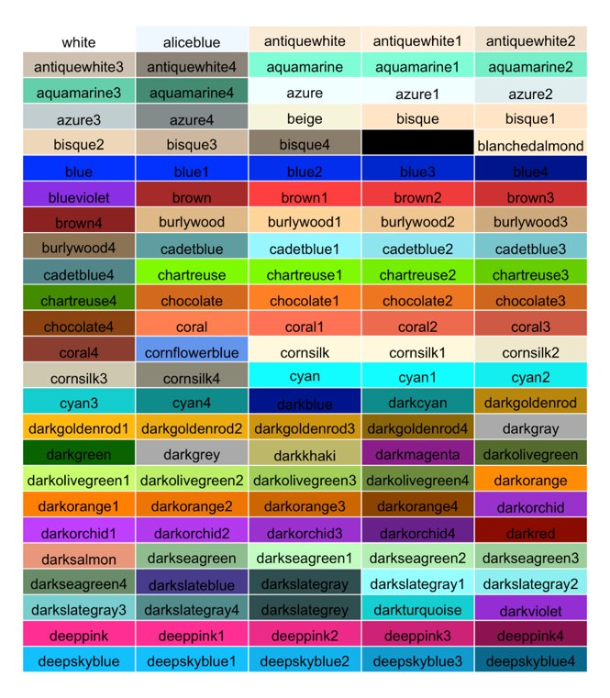
R color names
657 built-in color names
colors() to get a full list
Here is a subset -->
also possible to define colors:
Hex codes
RGB numbers
Numbers 1 to 8
www.nceas.ucsb.edu/~frazier/RSpatialGuides/colorPaletteCheatsheet.pdf

Slide 12
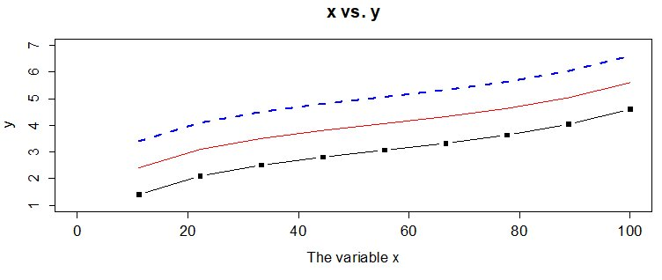
Customizing plots (II)
The plot() command takes further arguments to customize the plotting area:
xlim and ylim to set the limits on the x- and y-axis, respectively
xlab and ylab to set the labels for the x- and y-axis, respectively
main to set a title
x <- seq(0, 100, length.out=10)
y <- log(x) + (x/100)^5
plot(x,y, type="l", col="red",
ylim=c(1,7),
xlab="The variable x",
main ="x vs. y" )
lines(x, y+1, lwd=3,
lty="dashed", col="blue")
points(x, y-1, type="b", pch=15)

Slide 13
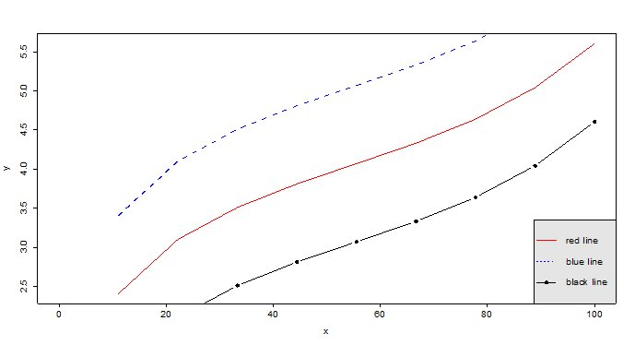
Customizing plots (III)
The legend() command adds a legend to plots:
x , y to set the numeric coordinates for positioning the legend.
OR x can be used by itself with a keyword for legend position: "bottomright", "bottom", "bottomleft", "left", "topleft", "top", "topright", "right", "center"
legend to set the text to appear in the legend
col to set the colours of points or lines
lty and lwd to set the line types and widths for lines appearing in the legend
pch to set the plotting symbols appearing in the legend
bty for box type around the legend ("o" for box, "n" for no box)
bg for background color
legend(x="bottomright",
legend=c("red line",
"blue line", "black line"),
lty=c(1,2,1),
pch=c(NA,NA,19),
col=c("red", "blue", "black"),
bg="gray90")

Slide 14
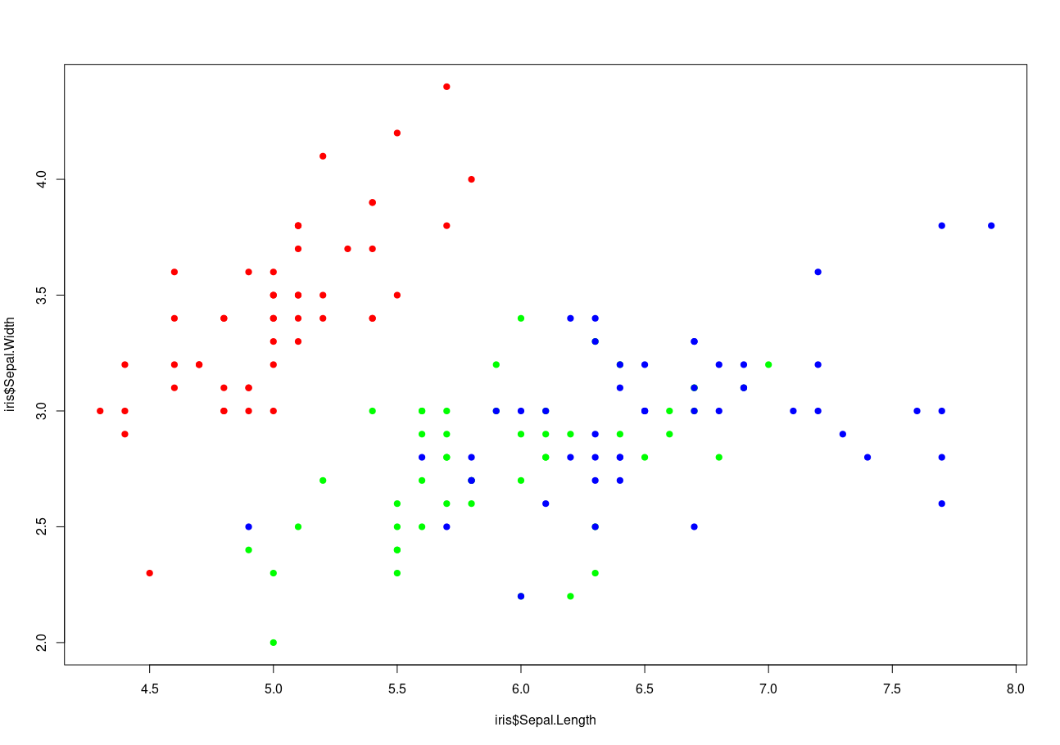
Customizing plots (IV)
When doing a scatterplot, it is common to color the points according to a categorical variable
data(iris)
colormap = c( "setosa" = "red" , 'versicolor' = 'green' ,
'virginica' = 'blue' )
plot(iris$Sepal.Length,
iris$Sepal.Width ,
col = colormap[ iris$Species ],
pch=19)

Slide 15
Digression: why does the previous trick work?
colormap = c( "setosa" = "red" , 'versicolor' = 'green' , 'virginica' = 'blue' )
# named vector: associate a label to some value (here a color)
colormap
setosa versicolor virginica "red" "green" "blue"
# selecting 1 elements in a named vector,
colormap["setosa"]
setosa
"red"
# nothing prevents you from repeating an index
colormap[c("setosa","virginica","setosa","setosa")]
setosa virginica setosa setosa "red" "blue" "red" "red"
# factor are auto-coerced to numeric in this case:
c('red','green','blue')[iris$Species]
[1] "red" "green" "blue" "red" ...

Slide 16
abline() (I)
abline() adds one or more straight lines through the current plot – vertical, horizontal or sloped.
Useful for
showing boundaries and cutoffs
fitting straight trend lines through the data (cf. lm())
Arguments:
abline(v=c(…) ): add vertical line(s) at the given x value(s)
abline(h=c(…) ): add horizontal line(s) at the given y value(s)
abline(a= ,b= ): add an affine line with intercept a and slope b
abline(reg=lm(…) ): add a trend line from a linear regression equivalent to abline(lm(…))

Slide 17
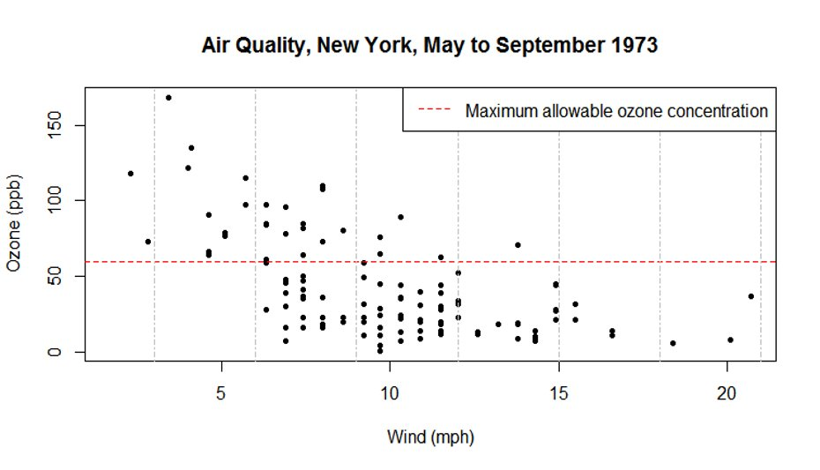
abline() (II) - horizontal and vertical lines
data(airquality) # Daily measurements, New York, May-Sept. 1973
plot(airquality$Wind, airquality$Ozone, pch=20,
xlab= "Wind (mph)", ylab="Ozone (ppb)")
abline(h=60, col="red", lty="dashed")
abline(v=seq(3,21,3), col="grey", lty="dotdash")
legend("topright",
"Maximum allowable
ozone concentration",
col="red",
lty="dashed")

Slide 18
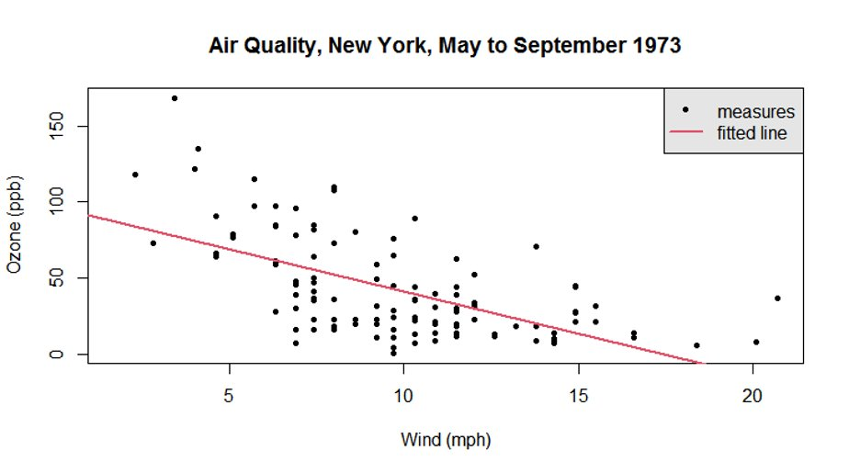
abline() (III) - trend line
plot(airquality$Wind, airquality$Ozone, pch=20,
xlab= "Wind (mph)", ylab="Ozone (ppb)")
abline(lm(airquality$Ozone ~ airquality$Wind), col=2, lwd=2)
legend("topright",
legend= c("measures",
"fitted line"), pch= c(20, NA),
lty = c(0, 1),
lwd=c(NA, 2),
col = c(1, 2),
bg = "gray90")

Slide 19
Let's practice - 7
Import the mouse data from the file course_datasets/mice_data_mod.csv.
This file contains the same data as mice_data.csv and in addition, two more columns.
Run str() to check your data frame: did it load correctly?
Convert genotype and diet to factor variables.
Make a scatter plot of respiratory rate against mouse weights using the function plot().
use solid circles as plotting symbol
add a title
customize the axis labels (“Weight [g]”, “Respiratory Rate [bpm]”)
color the points by genotype.
Fit a trend line using the function abline()
Add a legend for the genotype
EXTRA TASKS:
use the command data(airquality) to load the airquality dataset
Plot the relationship between wind speed (Wind) and temperature (Temp)
Color by Month
Add nice labels and a legend

Slide 20
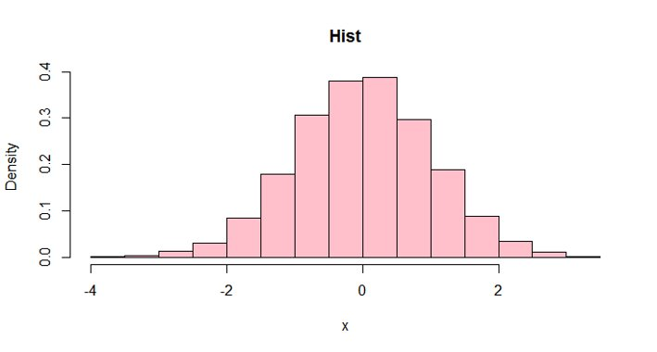
Histograms
hist() creates a histogram in a new plot (like plot). Main parameters:
breaks: guides the number of bins. Number or vector of breakpoints
freq:
TRUE : y-axis represents counts per bin
FALSE: y-axis represents density
x<- rnorm(10000) # 10000 random draw in a normal distribution
hist(x, freq=FALSE,
main="Hist",
col="pink")

Slide 21
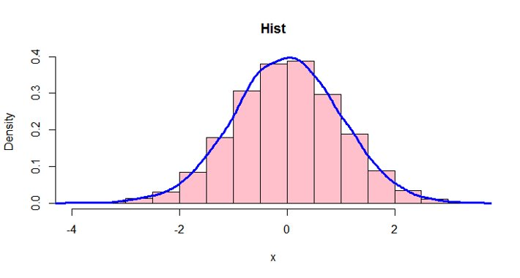
Histograms and density line
density() estimates the probability density of the data (kernel density estimates).
The output of density() can be given to the lines() function.
x<- rnorm(10000) # 10000 random draw in a normal distribution
hist(x, freq=FALSE,
main="Hist",
col="pink")
lines(density(x),
Col="blue",
lwd=3)

Slide 22
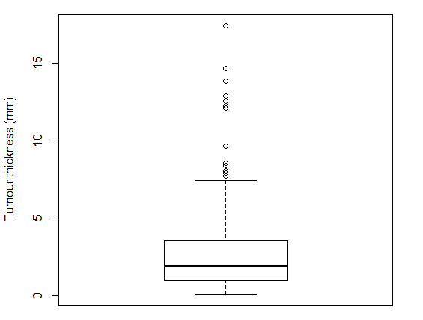
Boxplots (I) - anatomy
Example: melanoma thickness in 205 patients
Outliers
Median

Slide 23
Boxplots (II) - anatomy
Example: melanoma thickness in 205 patients
Outliers
Whisker: covers all points < Q3 + 1.5 * IQR
Median
Box: Interquartile range (Q1 to Q3)
Whisker: covers all points > Q1 - 1.5 * IQR

Slide 24
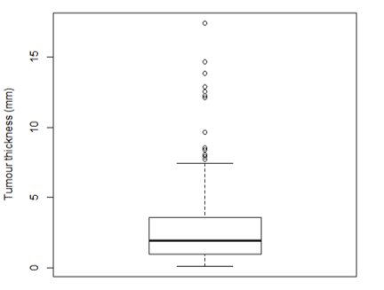
Boxplot (III) - plotting code
library(MASS)
data(Melanoma) # 205 patients with malignant melanoma
head(Melanoma)
time status sex age year thickness ulcer
1 10 3 1 76 1972 6.76 1
2 30 3 1 56 1968 0.65 0
3 35 2 1 41 1977 1.34 0
4 99 3 0 71 1968 2.90 0
5 185 1 1 52 1965 12.08 1
6 204 1 1 28 1971 4.84 1
boxplot(Melanoma$thickness,
ylab='Tumour thickness (mm)',
col='white')

Slide 25
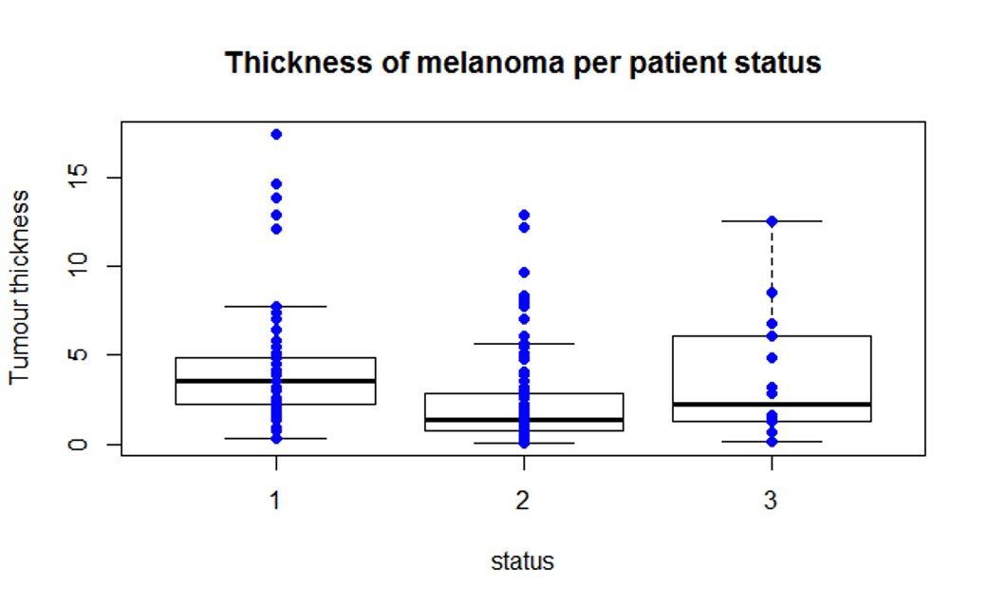
Boxplot (IV) - more boxplots
We want
separate boxplots for subgroups
individual points overlaid
status:
died from melanoma
alive
dead from other causes

Slide 26
Boxplot (V) - data preparation
# check if the grouping variable is a factor (it is not!)
str(Melanoma)
'data.frame': 205 obs. of 10 variables:
$ time : int 10 30 35 99 185 204 210 232 232 279 ...
$ status : int 3 3 2 3 1 1 1 3 1 1 ...
$ sex : int 1 1 1 0 1 1 1 0 1 0 ...
$ age : int 76 56 41 71 52 28 77 60 49 68 ...
$ year : int 1972 1968 1977 1968 1965 1971 1972 1974
$ thickness: num 6.76 0.65 1.34 2.9 12.08 ...
$ ulcer : int 1 0 0 0 1 1 1 1 1 1
# coerce the grouping variable to factor
Melanoma$status <- factor(Melanoma$status)

Slide 27
Boxplot (VI) - plotting code
Method 1: data subsets
boxplot(Melanoma$thickness[Melanoma$status=="1"],
Melanoma$thickness[Melanoma$status=="2"],
Melanoma$thickness[Melanoma$status=="3"],
main="Thickness of melanoma per patient status",
xlab="status", ylab="Tumour thickness",
names=c("1","2","3"))
points(Melanoma$status, Melanoma$thickness,
col="blue",pch=19) #adds the actual data points to the plot
Method 2: Formulas
boxplot(thickness ~ status, data=Melanoma,
main="Thickness of melanoma per patient status",
xlab="status", ylab="Tumour thickness")
points(thickness ~ status, data=Melanoma,
col="blue", pch=19) #adds the actual data points to the plot

Slide 28
Boxplot (VII) - result
Both methods give the same result:

Slide 29
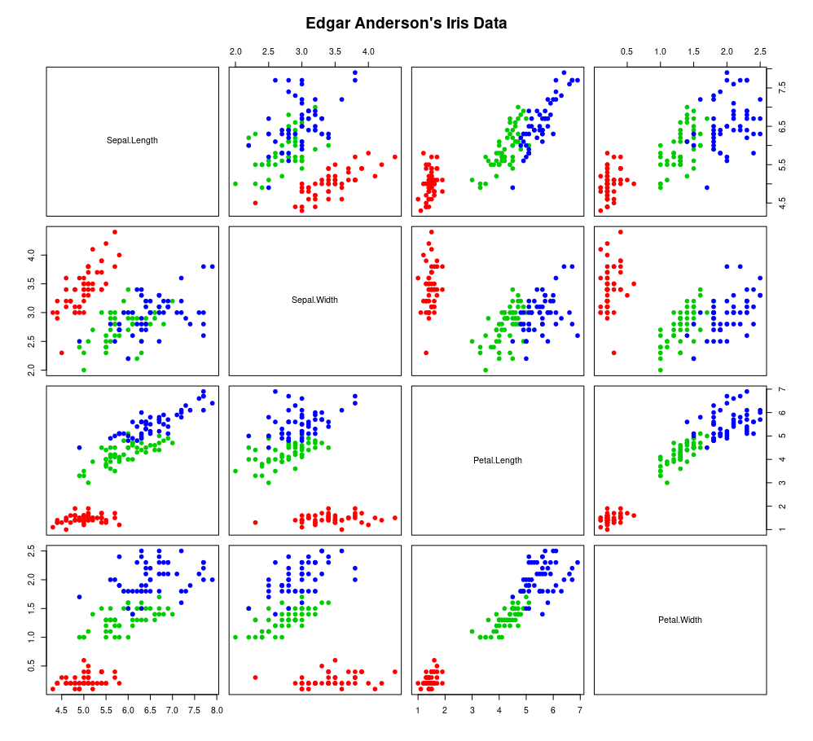
Pairs scatter plot - pairs()
If x is a matrix or a data frame, pairs() draws
all possible bivariate plots between the
columns of x.
data(iris)
pairs(iris[,1:4], pch=19,
col=colormap[ iris$Species ])

Slide 30
Let's practice - 8
This is a continuation of the previous practice: we will continue to plot the mice data
Plot a histogram of mouse weight and customize it with title, labels, colors. Represent the density line on top.
Make boxplots of weights from WT and KO mice. Customize with title, labels, colors.
Optional: Repeat 2 with diet instead of genotype.
EXTRA TASKS
Come back to the airquality dataset
Make boxplot of temperatures per month
Make boxplot of wind speed per month
for each of these plots, add labels as well as overlay the actual points onto the boxplots

Slide 31
Permanent graphic changes (I)
The function par() allows to change the default values of many plotting parameters.
All future calls to graphics functions will be affected.
Example 1: set plotting colors and symbols
par(col="red", pch=15)
Example 2: set margin widths for subsequent plots
mar sets plot margins in number of lines
mai sets plot margins in inches
use vectors of 4 values (c(0,1,1,2)) for the bottom, left, top, and right margins
par(mar=c(5.1,4.1,4.1,2.1)) #set margins in lines
par(mai=c(1.02,0.82,0.82,0.42)) #set margins in inches

Slide 32
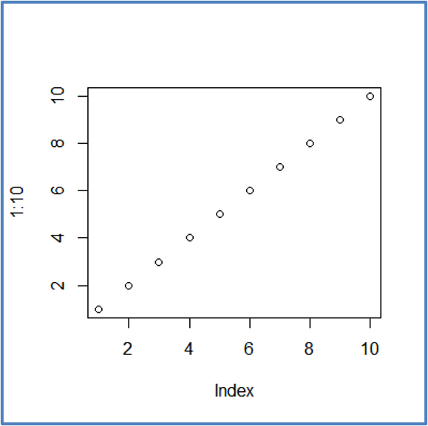
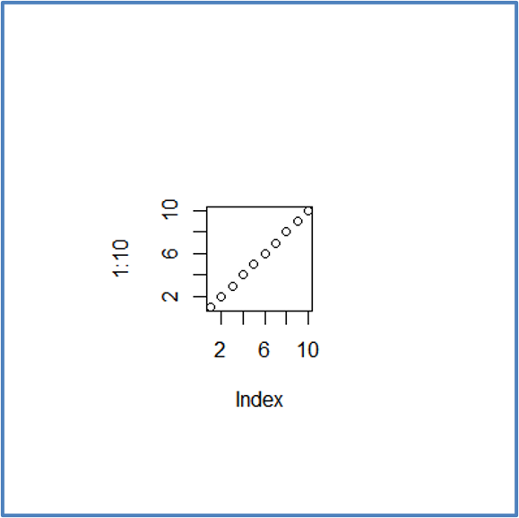

Permanent graphic changes (II)
Normal margins
# bottom, left, top, right
par(mar=c(5.1,4.1,4.1,2.1))
Plot(1:10)
Wide margins
# bottom, left, top, right
par(mar=c(8.1,8.1,8.1,8.1))
Plot(1:10)

Slide 33
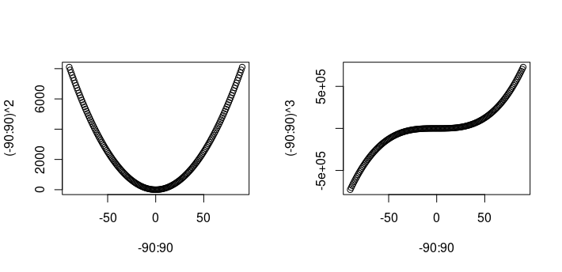
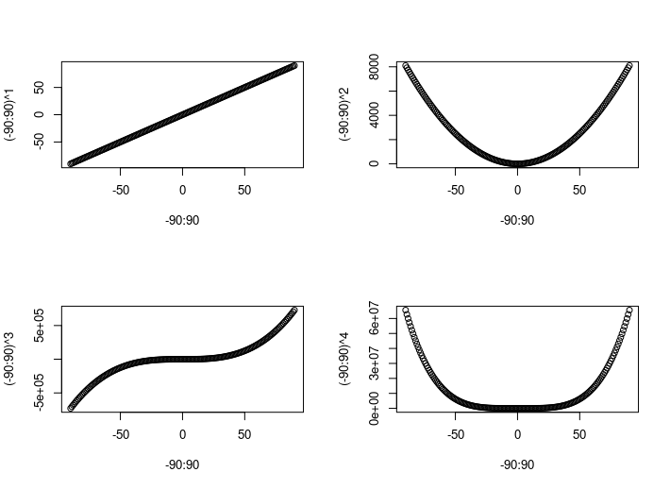
Permanent graphic changes (III)
par() can be used to generate a multi-panel figures with the argument
mfrow: a vector with two elements ( number of rows, number of columns)
par(mfrow=c(1,2))
plot(-90:90 , (-90:90)**2 )
plot(-90:90 , (-90:90)**3 )
par(mfrow=c(2,2))
plot(-90:90 , (-90:90)**1 )
plot(-90:90 , (-90:90)**2 )
plot(-90:90 , (-90:90)**3 )
plot(-90:90 , (-90:90)**4 )

Slide 34
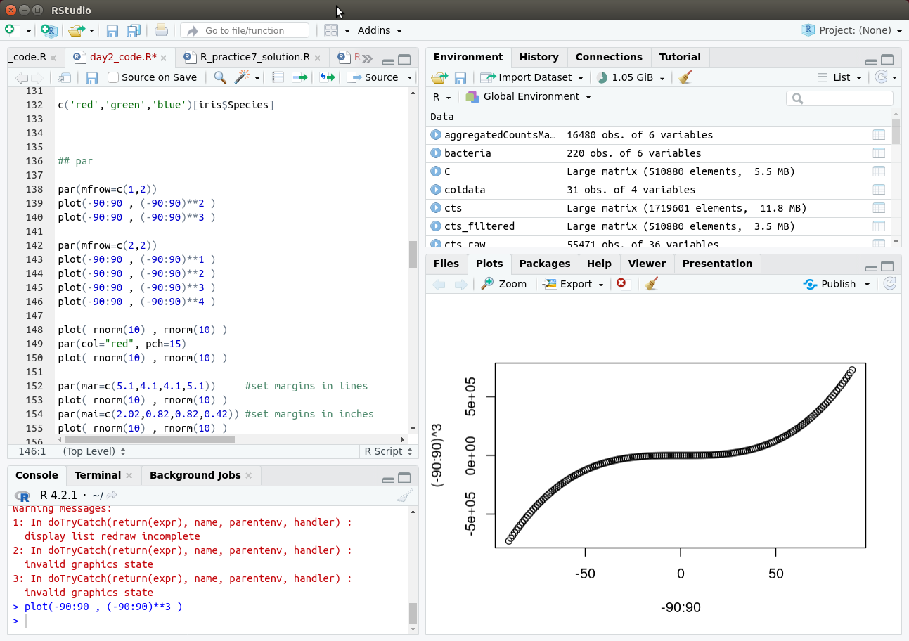

Permanent graphic changes (IV)
Current settings of par(): call par() without arguments
Resetting par()
Restart R or switch Rstudio projects
dev.off() : closes the most recent plot
graphics.off() : closes all plots
Rstudio broom icon

Slide 35
Saving figures to files
Programmatic method: surround the plotting code with
Before format function: pdf(), png(), jpeg(),…
After: dev.off()
pdf(file="quadratic_cubic.pdf", width=7, height=4, paper="a4")
plot(-90:90,(-90:90)**2)
dev.off()
Alternatively, you may use Rstudio interface:
Plots > Export > Save as Image (PNG,JPEG,TIGG,BMP)
Plots > Save as PDF

Slide 36
Graphic export functions
Use correct file extension:
postscript(file="a_name.ps", …)
pdf(file="…pdf", …)
jpeg(file=" …jpg", …)
png(file=" ….png", …)
Different devices have different set of arguments: height=, width=, res=, paper=, pointsize=, ...
png, jpeg, tiff (raster formats): width and height are in pixels.
pdf and postscript (vector formats): width and height in inches. Default values are 7.
Tip: A4 = 8.3" x 11.7“; set the width and height a little smaller for printing to A4 size
pdf and postscript have an argument "paper".
paper="a4" for A4 in portrait orientation, paper="a4r" for A4 in landscape orientation

Slide 37
Choosing an image file format
Raster graphics (png, tiff, jpeg):
file sizes depend on the image size (number of pixels)
once created, stretching the image leads to poor quality
Vector graphics (pdf, ps, eps, svg):
file sizes depend on the number of drawing actions (e.g. number of points, lines,...)
all elements can be scaled as desired
Embedding image files in MS Office documents (Word, PowerPoint):
In Windows, png and tiff work best, pdf can get blurry.
In macOS, pdf works well.
Can also export plot from RStudio to clipboard, then paste.
Publication-quality figures:
Vector graphics (pdf, eps) tend to be easier to adapt as they can be resized
File size tip: when many points are plotted, pdfs can become large in file size and slow to display. When this is an issue, consider png.

Slide 38
Let's practice - 9
This is a continuation of the previous practice: we will continue to plot the mice data
Make a multi-panel figure with the four graphics (from the previous exercises) on one page
Change the code to export the figure to a pdf file with paper size A4. Set width and height arguments in the call to pdf() to make it look nice.
Optional: Export an histogram (from previous exercise) to a png file. Set width and height arguments in the call to png() to make it look nice.
EXTRA TASKS
Choose 1 and try to tweak the different elements color. For example, try to change the background color, the color of the title, the thickness and color of axis labels, ...

Slide 39
Plots are initiated with: plot(), hist(), boxplot(), ... Further modification with: points(), lines(), abline(), … examples: https://r-graph-gallery.com/index.html

Slide 40

Thank you
sib.swiss

